Slide 1
Economic Consequences of War
A Comparative Study Across Multiple Countries
23BEC1069 Gautham R 23BEC1072 Nukilan J 23BEC1088 Lalithkishore M 23BEC1270 Athithiya P A
A project for Probability and Statistics Course

Slide 2

WAR
A war, irrespective of the reason, always has serious after-effects.

Slide 3
Objective
To model the probability of a nation's economic recovery post-war
To analyse key indicators (GDP, inflation, employment, and infrastructure)
To develop a predictive framework that can assist policymakers
To understand and navigate the complex challenges of post-war economic recovery

Slide 4
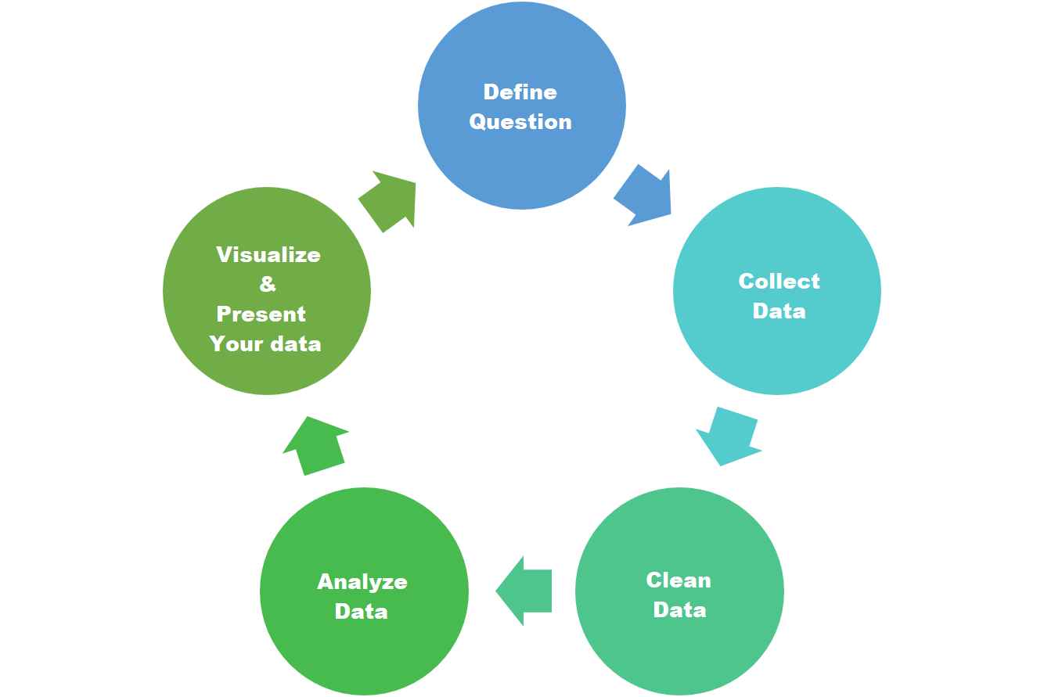
DataSet Used for Analysis
GDP Growth
Unemployment
Inflation
Public Debt
Foreign Investment

Slide 5
Expected Outcome
Immediate Economic Disruption:
GDP Contraction
Inflation
Unemployment
Fiscal Strain, Debt Accumulation, International Aid and Economic Dependence:
Increased Government Spending
Public Debt Surge
Reliance on Aid
Foreign Investment Decline
Disruption of Trade and Supply Chains:
Export Decline
Import Shortages

Slide 6
Expected Outcome
Social and Economic Inequality and Long-term Economic Instability:
Rising Inequality
Poverty Increase
Economic Fragmentation
Slow Recovery
Impact on Financial Markets and Currency:
Currency Devaluation
Stock Market Decline
Humanitarian Crisis and Demographic Changes:
Humanitarian Crisis
Demographic Shifts

